Slide 1



SITS Demonstration in SEPAL
Karine R. Ferreira, Rolf Simões and Gilberto R. Queiroz
National Institute for Space Research, Brazil – INPE
Notes:
Hi everybory, my name is Karine Ferreira, I work at the Nationa ... in Brazil
And today, we, Rolf, Gilberto and I, will present a demonstration of the R package sits running in the SEPAL platform.

Slide 2

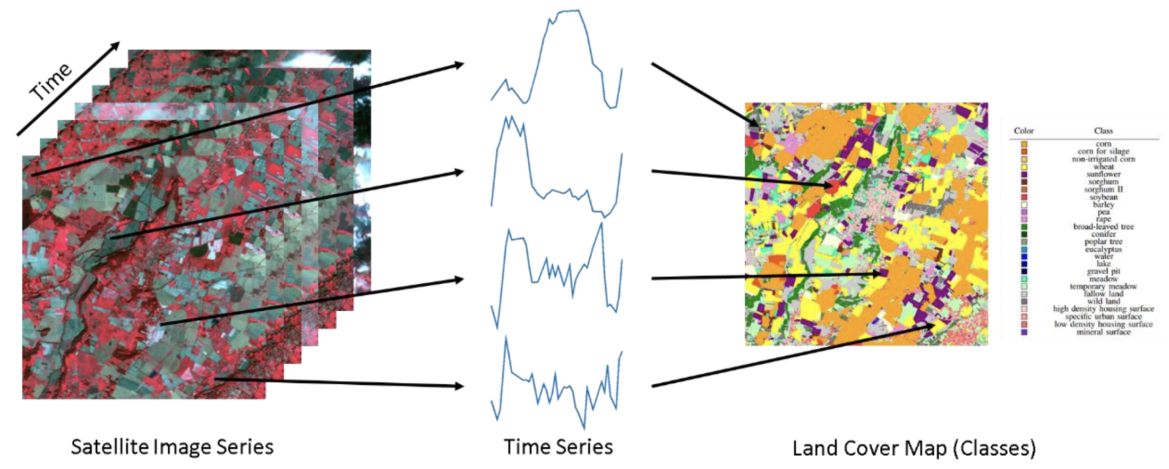
Land classification with satellite image time series
image: F Petitjean, Monash Univ
Notes:
Sits is an R package for Satellite Image Time Series Analysis for Earth Observation Data Cubes.
This package provides a simples API for a complete and complex workflow for land classification from big EO data sets.
It provides funcionalities to:
Create and define earth observation data cubes
Assess and improve land use and cover samples using neural network and Self-Organizing maps (SOM)
Train different kinds of machine learning methods using land use and cover samples
Classify the data cube using the trained model.
Perform some kind of post-processing (such as smoothing) to generate the final map.
Spatial smoothing methods remove outliers from the classification.

Slide 3
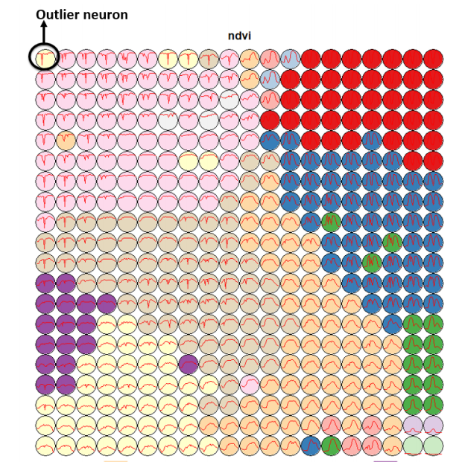
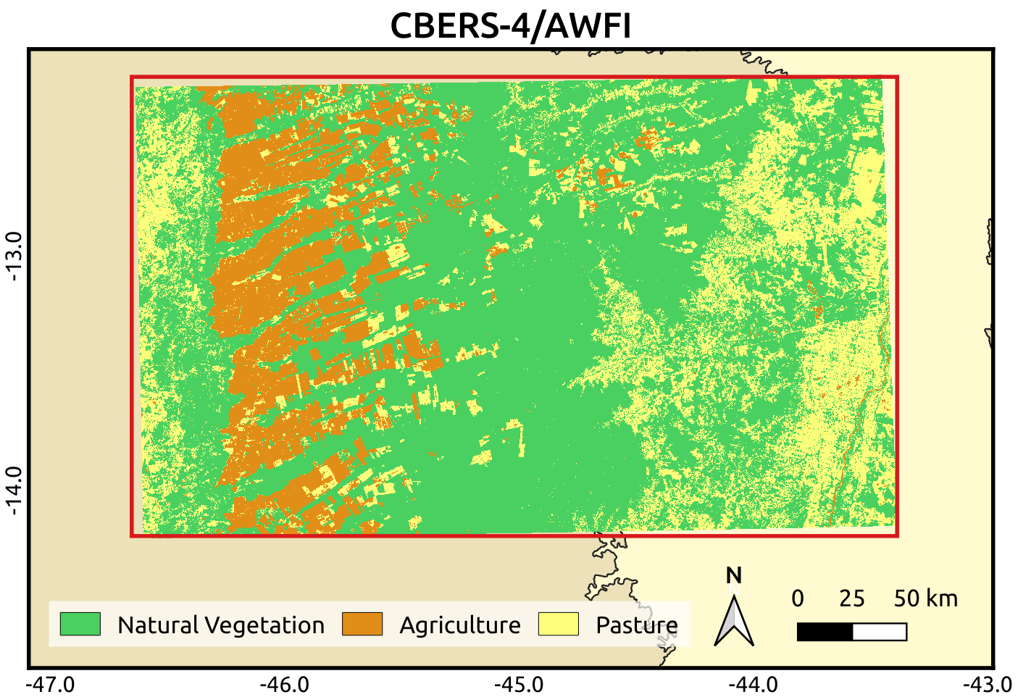
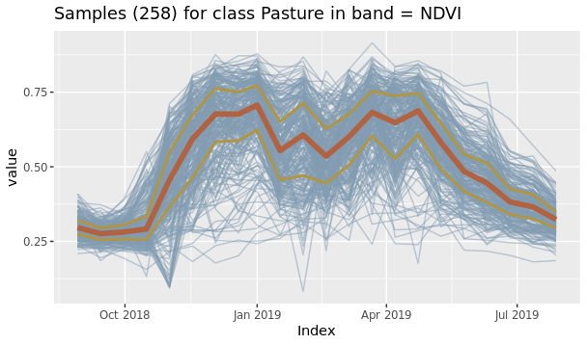
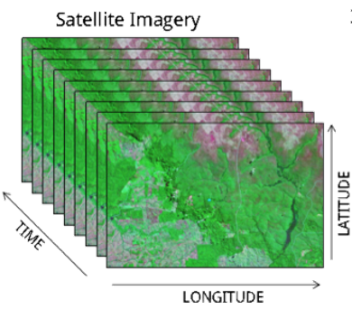

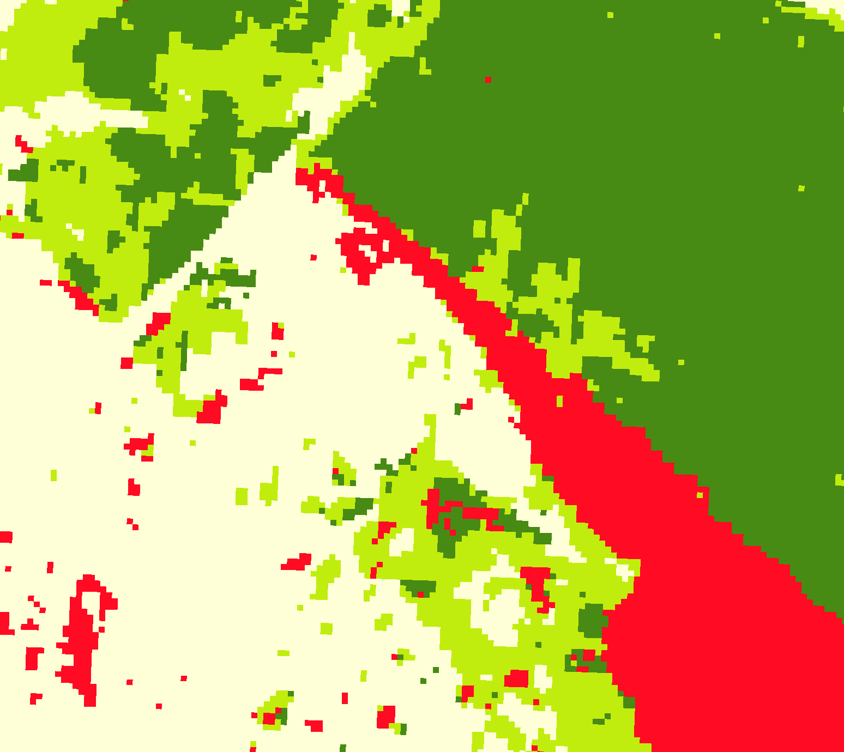
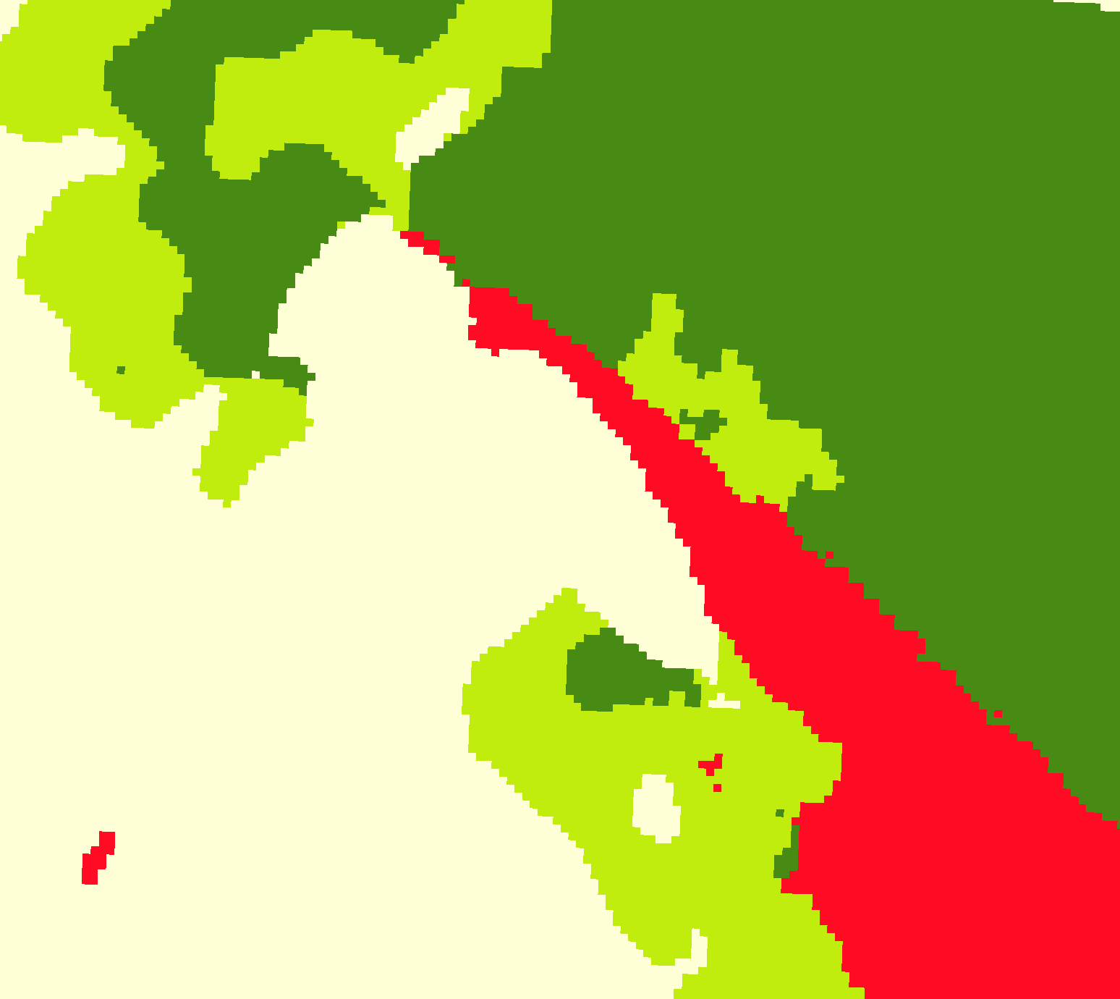
Complete land classification workflow
LUCC samples
Quality Analysis
LUCC maps
EO data cubes
ML models
Classification and smoothing
Notes:
Sits is an R package for Satellite Image Time Series Analysis for Earth Observation Data Cubes.
This package provides a simples API for a complete and complex workflow for land classification from big EO data sets.
It provides funcionalities to:
Create and define earth observation data cubes
Assess and improve land use and cover samples using neural network and Self-Organizing maps (SOM)
Train different kinds of machine learning methods using land use and cover samples
Classify the data cube using the trained model.
Perform some kind of post-processing (such as smoothing) to generate the final map.
Spatial smoothing methods remove outliers from the classification.

Slide 4
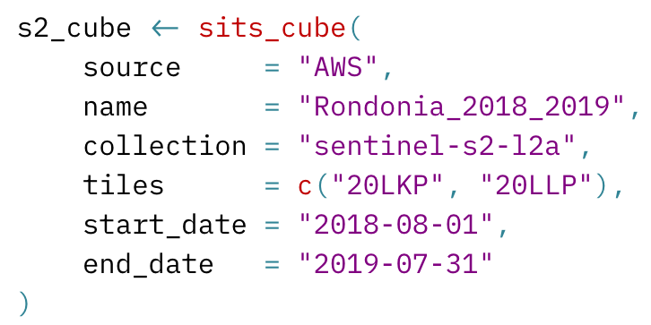






Data cubes from different providers
Local files
Earth on AWS
Planetary Computer
Digital Earth Africa
Brazil Data Cube
Notes:
Sits is able to access data cubes and image collection from different providers, such as Earth on AWS and Digital Earth Africa, based on STAC metadata.
In the sitis function “sits_cube”, the user defines the Earth observation data cube that he or she will work: its source (AWS ou Local), collection name, tiles and period

Slide 5
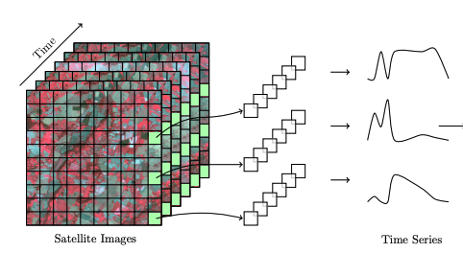
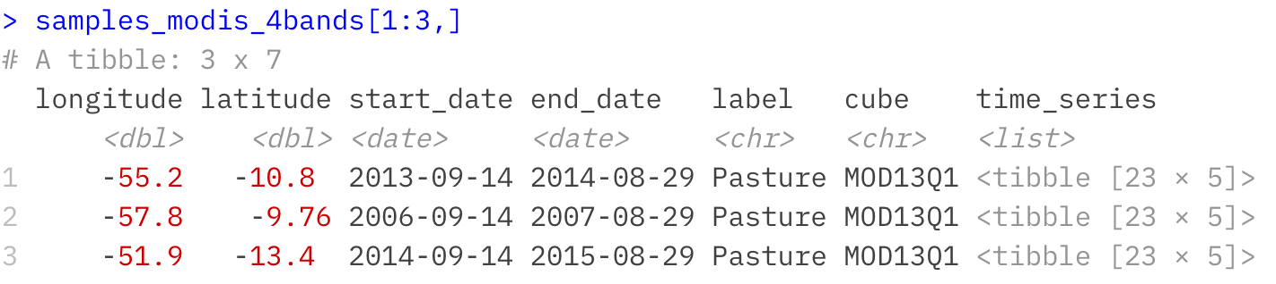
Image time series samples defined by user
Notes:
Sits provides data structures to represent in R EO data cube and image time series.

Slide 6
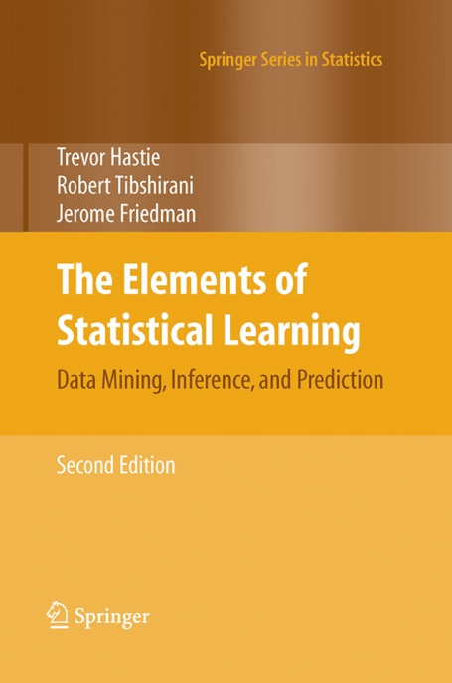
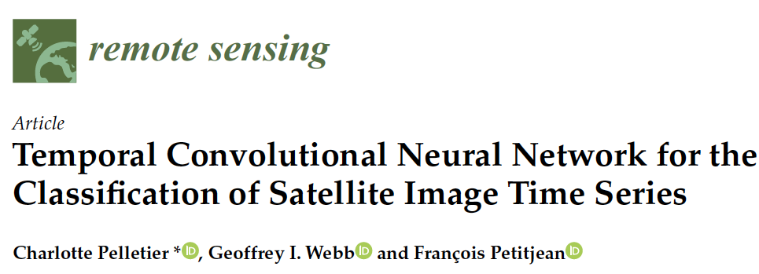
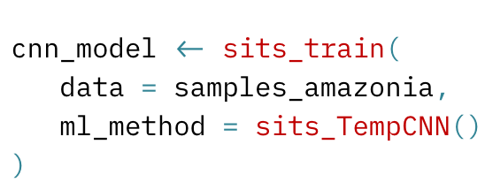

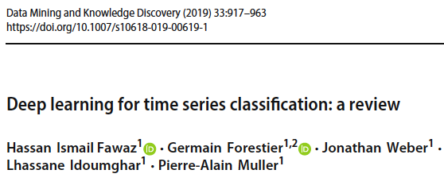
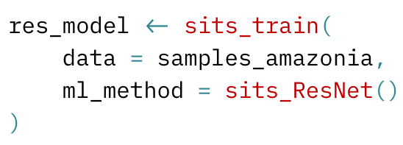
Machine learning and deep learning methods
Notes:
Sits supports different kinds of machine learningand deep learning methods methods, such as random forests, support vector machines, multi-layer perceptrons, temporal convolution neural networks (TempCNN) and InceptionTime described in these research papers and
The user defines the method and its specific parameteres in the sits function “sitis_train” (as you can see here).
========
The first group of methods does not explicitly consider spatial or temporal dimensions;
these models treat time series as a vector in a high-dimensional feature space.
From this class of models, sits includes random forests, support vector machines,
extreme gradient boosting, and multi-layer perceptrons.
The second group of models comprises deep learning methods designed to work
with image time series. Temporal relations between observed values in a time series
are taken into account. Time series classification models for satellite data include 1D
convolution neural networks (1D-CNN), recurrent neural networks (RNN),
and attention-based deep learning. The sits package supports a set of 1D-CNN
algorithms: TempCNN, ResNet, and InceptionTime.
Since sits is aimed at remote sensing users who are not machine learning experts,
the package provides a set of default values for all classification models. These settings
have been chosen based on extensive testing by the authors. Nevertheless, users can
control all parameters for each model. The package documentation describes in detail
the tuning parameters for all models which are available in the respective functions.

Slide 7
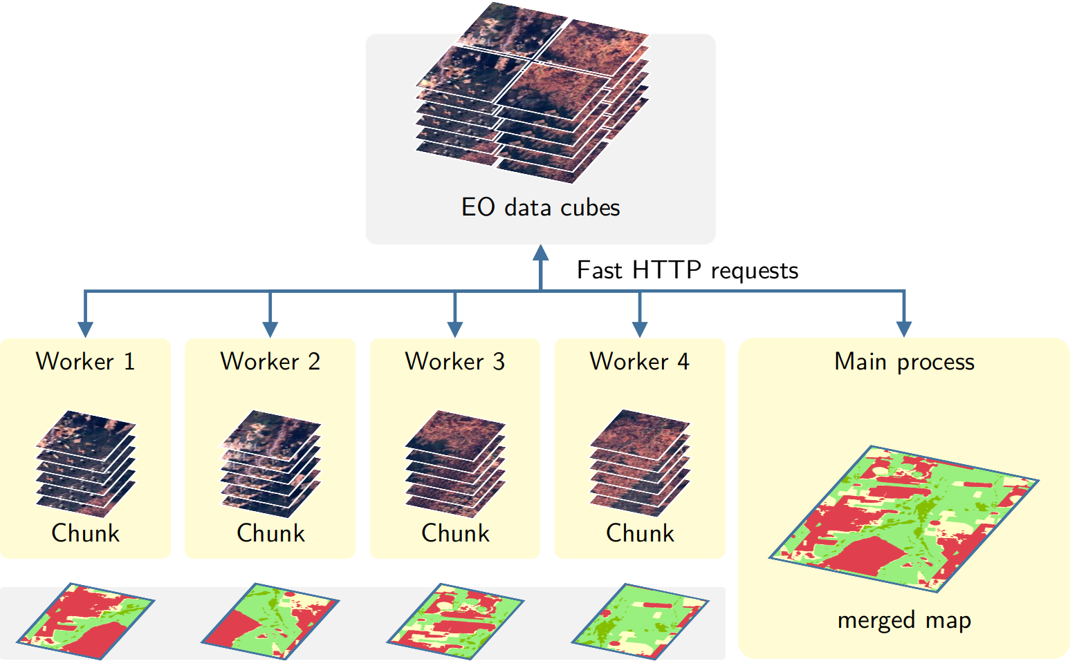
Transparent and efficient parallel processing
Notes:
Image classification in sits is done in parallel.
Sits divides data cubes into chunks and processes them in parallel, based on the number of cores and available memory
defined by the user in the funtion “sits_classify”.
========
, by a cluster of independent workers linked to one or more virtual machines.
The best trade-off has to be determined by the user, considering issues such disk read speed, number of cores in the server, and CPU performance. The memsize parameter controls the size of the main memory (in GBytes) to be used for classification. A practical approach is to set memsize to about 30% of the total memory available.

Slide 8

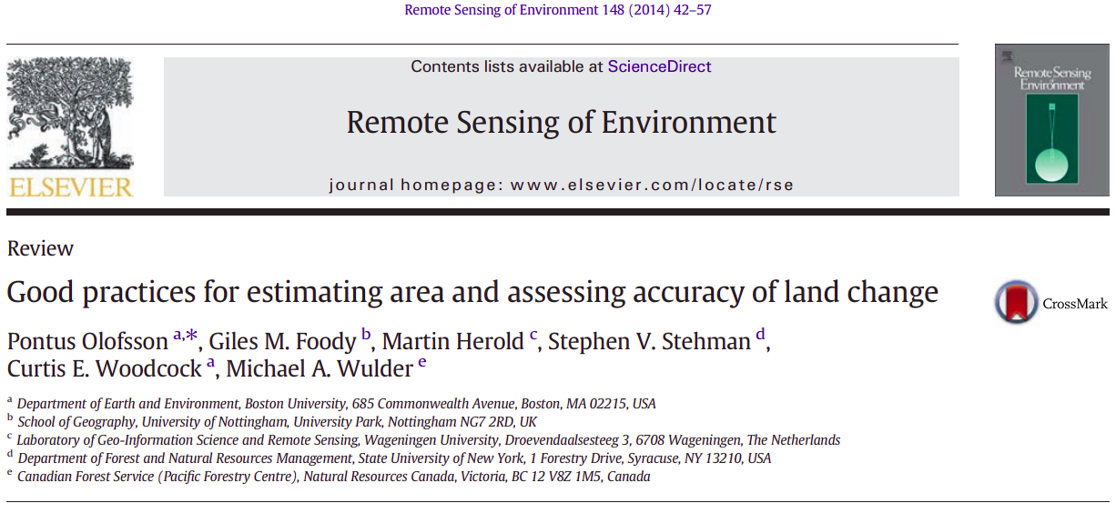
Accuracy assessment supports GFOI best practices

Slide 9
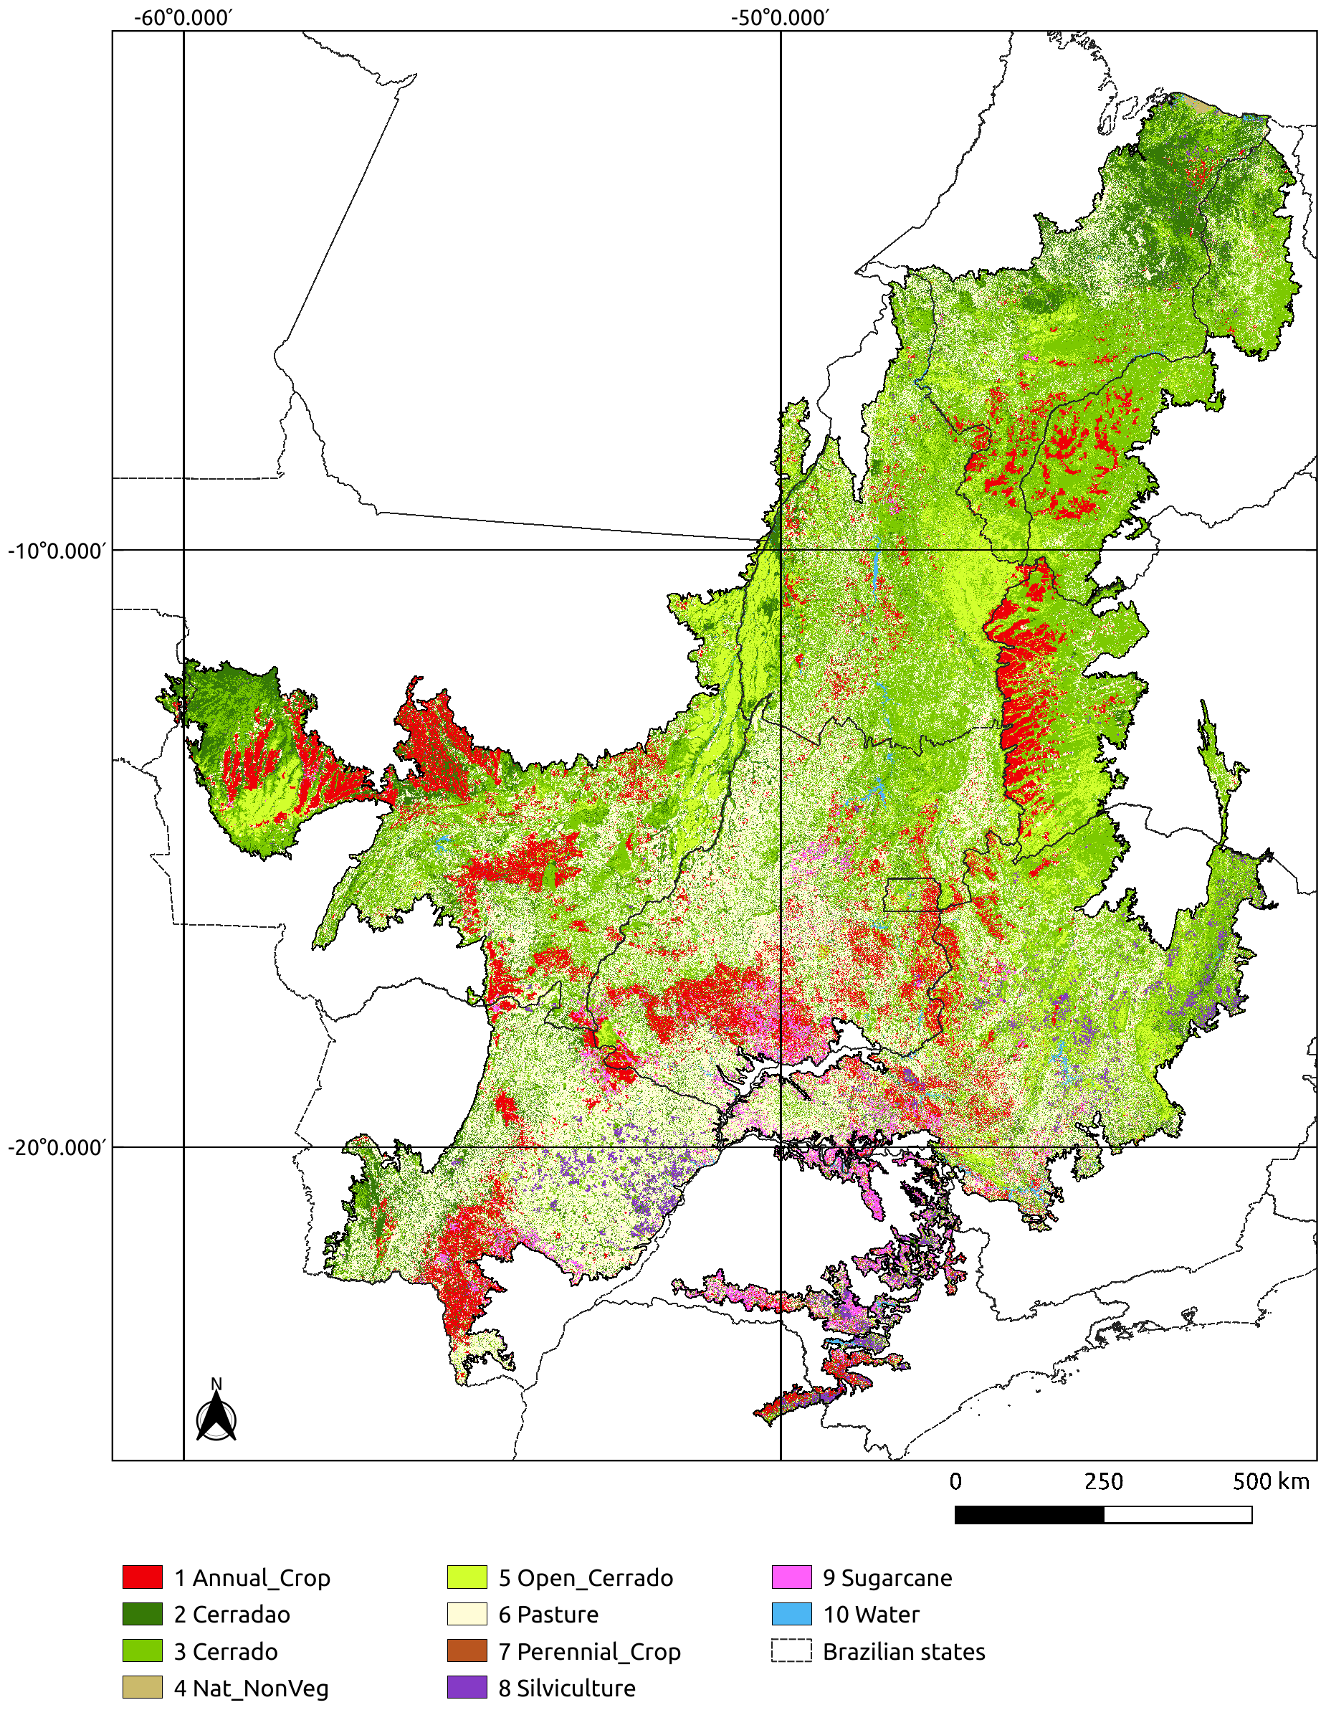
LULC classification
Cerrado biome (200 million ha)
LULC map for year 2018
48,850 samples (TempCNN model)
Landsat-8 16-day time series
8 TB processed in 24 hours
10 LULC classes (86% accuracy)

Slide 10
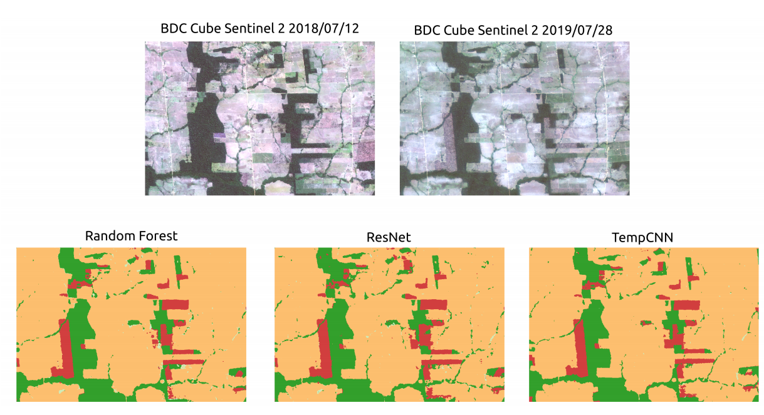
Measuring deforestation using time series
90%
accuracy!
Notes:
These pictures show a region in the Brazilian Amazon forest that was deforested in a certain time between july of 2018 and july of 2019.
Using Sentinel2 data cube and its time series with all available observations between july of 2018 and july of 2019, we can detect this deforestaion using different machine learning methods, Randon Forest, ResNet and TempCNN, with an accuracy of 90%.

Slide 11
Demonstration
https://github.com/e-sensing/sits

